Slide 1


Digital Identity Wallet using Blockchain
By:
Akram Merouani
Kiran Sohi
Ritu Dhar
Yvonne Colangelo

Slide 2

Problem Statement
Most online transactions require that individuals disclose specific personal information before they can proceed to access services. For instance, before financial transactions can be carried out on platforms such as Amazon Pay, PayPal and Google Wallet, among others, users are always required to input their sign up/login details -- i.e., financial and personal details.
Thus, every time an individual discloses this information, it gets stored on numerous internet databases. As such, digital clones of one and the same individual spring into existence across these different platforms. This also exposes a lot of security issues.
The estimated amount of global money laundering is around $2 trillion per year. This figure is almost equal to the entire GDP of Italy, the world’s 8th largest economy.
Many banks spend approximately $900 million to $1.3 billion annually to improve and manage their KYC and AML processes.
Source: https://www.unodc.org/unodc/en/money-laundering/overview.html
https://www.forbes.com/sites/forbestechcouncil/2018/07/27/how-blockchain-can-solve-identity-management-problems/?sh=304dd21a13f5

Slide 3

Our Solution
Creating Digital Identity on Blockchain

Slide 4
What is KYC?
KYC stands for "Know Your Customer".
It is a process used by companies and organizations to verify the identity of their customers or clients.
The KYC process involves collecting personal information from the customer, such as their name, address, and government-issued identification. This information is then verified by a third-party service provider, who checks it against various databases to ensure its accuracy. Once the KYC process is complete, the customer is granted access to the company's products or services.
KYC is an important aspect of regulatory compliance, and failure to comply with KYC requirements can result in legal and financial penalties.

Slide 5

Why Blockchain?
It is a decentralized, distributed database that is maintained by a network of computers, rather than a central authority.
Blockchain uses a shared and immutable ledger that can only be accessed by members with permission.
Users store their ID data and credentials in a decentralized identity wallet app, and the blockchain enables this data to be instantly verifiable without having to contact the issuer.

Slide 6
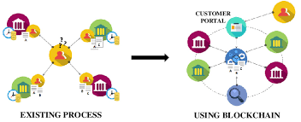
KYC in Blockchain
KYC in blockchain helps to build trust among users and investors in the network. This is done to prevent fraud, money laundering, and other criminal activities on the network.

Slide 7
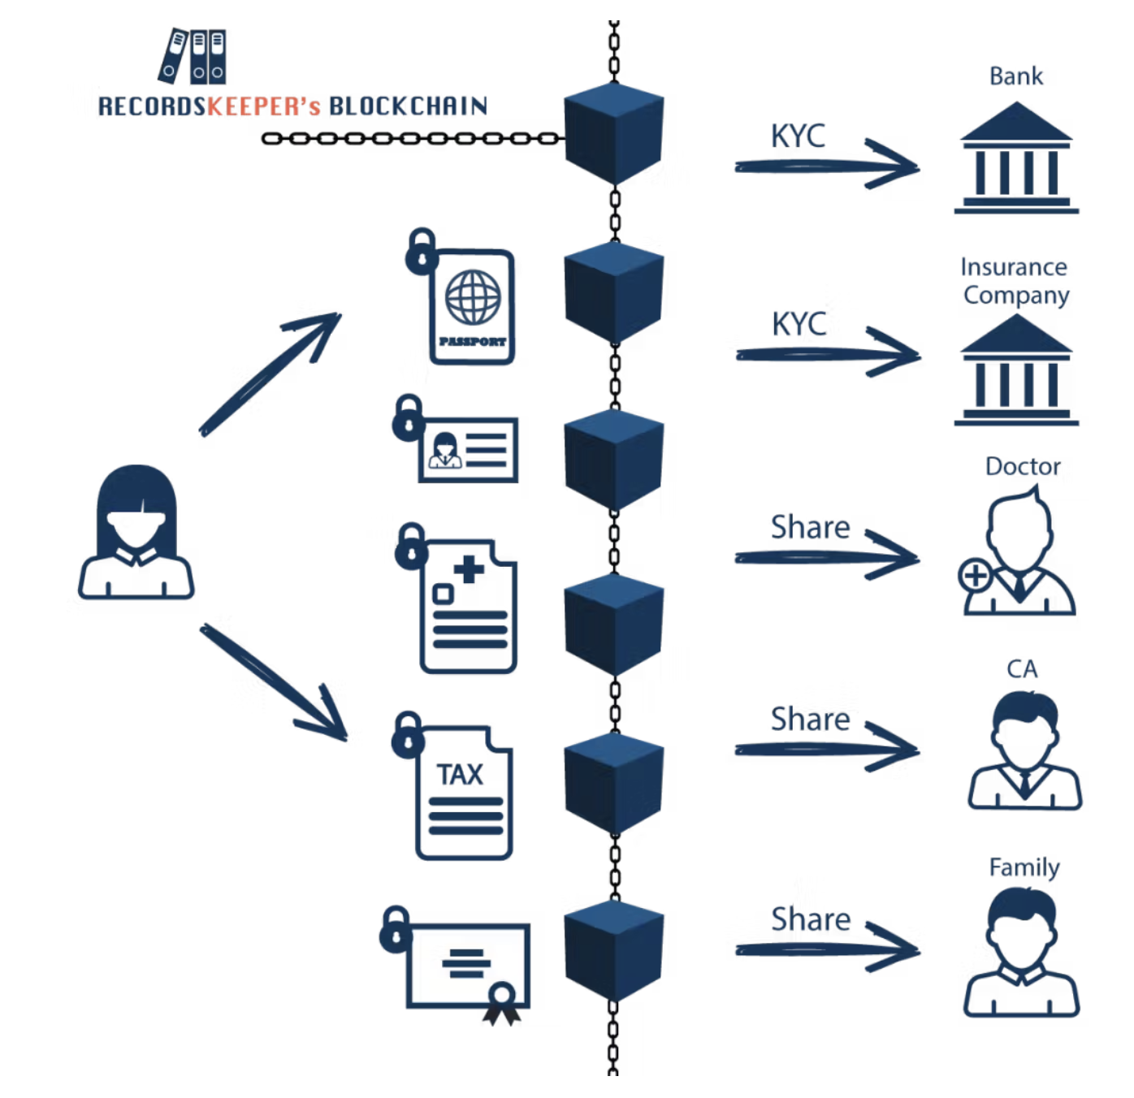

Slide 8
Smart Contract for KYC chain
Define the KYC process: Define the steps involved in the KYC process, such as collecting customer information, verifying the information, and storing it on the blockchain.
Write the smart contract code: Use a programming language ie Solidity to write the smart contract code. The code should include functions for collecting customer information, verifying the information, and storing it on the blockchain.
Define the data structure: Define the data structure for storing customer information on the blockchain. This can include fields such as name, address, date of birth, and identification number.
Implement a verification process to ensure that the customer information is accurate and valid. This can include verifying the customer's identification documents and conducting background checks.
Deploy the smart contract: Deploy the smart contract on the blockchain network. Once deployed, the smart contract will automatically execute the KYC process when triggered by certain conditions.
Test the smart contract: Test the smart contract to ensure that it is functioning as intended and that customer information is being securely stored on the blockchain.

Slide 9
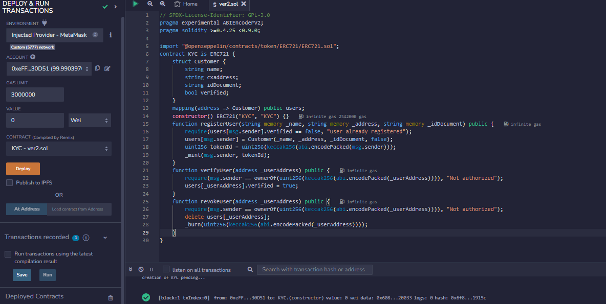

Slide 10
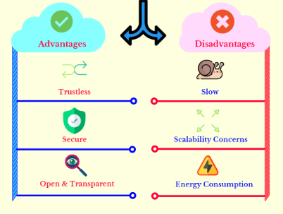

Slide 11

Conclusion
KYC chain reduces the time it takes to process and gather information with very few resources required for monitoring and assessing user behaviour for anomalies. The time and cost saved in turn can be used to find solutions to more complex KYC challenges.
However, blockchain cannot solve all the issues faced in KYC management. After the data is acquired, financial institutions still require to validate the information.
KYC chain when used in combination with other technologies such as AI can showcase high potential to help institutions reduce the cost and time linked with the KYC process.

